Slide 1

Data Link Layer
Lecture 14 | CSE421 –Computer Networks
Department of Computer Science and Engineering School of Data & Science

Slide 2


Based on Chapter 6 The Link Layer and LANs
Computer Networking: A Top Down Approach
7th edition Jim Kurose, Keith Ross Pearson/Addison Wesley April 2016
The slides are adapted from Kurose and Ross, Computer Networks 7th edition, Kurose and Ross.
All material copyright 1996-2016
J.F Kurose and K.W. Ross, All Rights Reserved

Slide 3
Chapter 6: Link layer and LANs
Objectives:
understand principles behind link layer services:
error detection, correction (done in CSE320)
sharing a broadcast channel: multiple access (done in CSE320)
Framing - link layer addressing
ARP
local area networks: Ethernet

Slide 4
Application
Presentation
Session
Transport
Introduction to Link Layer
Network
Data link
Physical

Slide 5
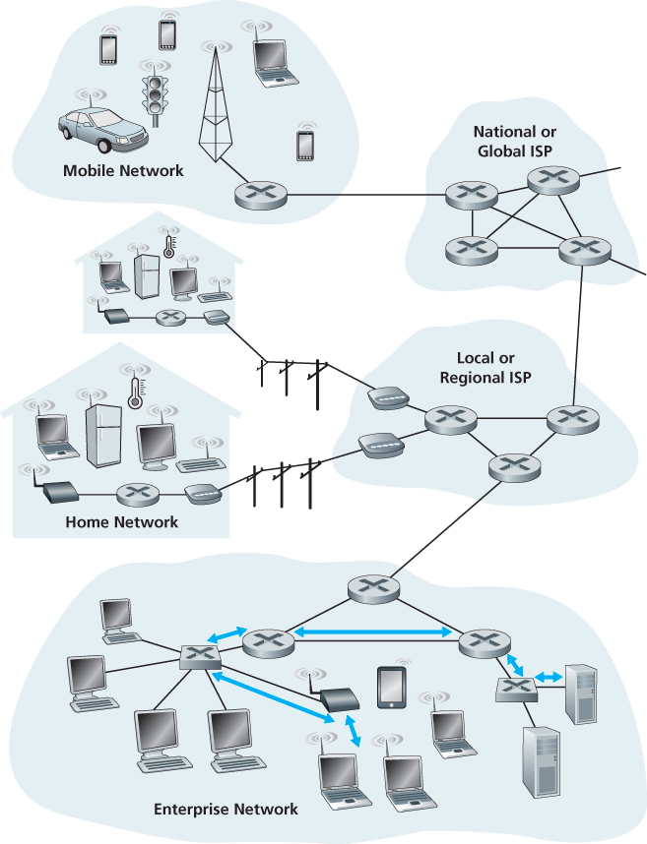
Link Layer Terminology
Nodes : hosts and routers
Links:
wired links
wireless links
Frame : layer-2 packet
The data-link layer is responsible for transferring a datagram from one node to its directly connected (physically adjacent) node over a link.

Slide 6
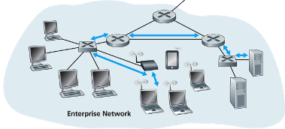
Link layer: context
As data moves through a network, it can travel over many types of links.
e.g., Ethernet on first link, frame relay on intermediate links, 802.11 on last link
Each link uses its own rules (protocols) to send the data.
WAN Protocol : Frame Relay
Ethernet
Ethernet
802.11

Slide 7









Analogy
Transportation analogy:
trip from Home to Cox’s Bazaar
Uber Car : Home to Dhaka Airport
Plane: Dhaka to Chittagong
Bus: Chittagong to Cox’s Bazaar
tourist = datagram
transport segment = communication link
transportation mode = link layer protocol
travel agent = routing algorithm

Slide 8
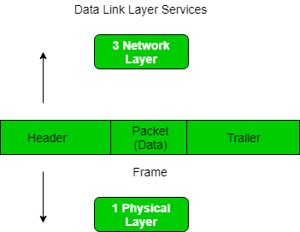
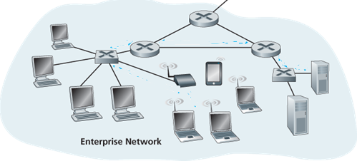
Link layer functions/services
Framing
Breaks data into frames (with header + trailer).
“MAC” addresses used in frame headers to identify source, destination devices.
Link access:
Decides how to send a frame to the link
Manages sharing if many devices use the same channel.
Prevents or controls collisions in multi-user networks.
Sets rules for sending data on the link.

Slide 9
Link layer functions/services
Reliable delivery between adjacent nodes
Makes sure frames are delivered correctly to the next device.
Seldom used on low bit-error link (fiber, some twisted pair)
Important on wireless links: high error rates
Q: why both link-level and end-end reliability?
Flow control
Manages the speed of data between sender and receiver.
Prevents the sender from overwhelming the receiver.

Slide 10
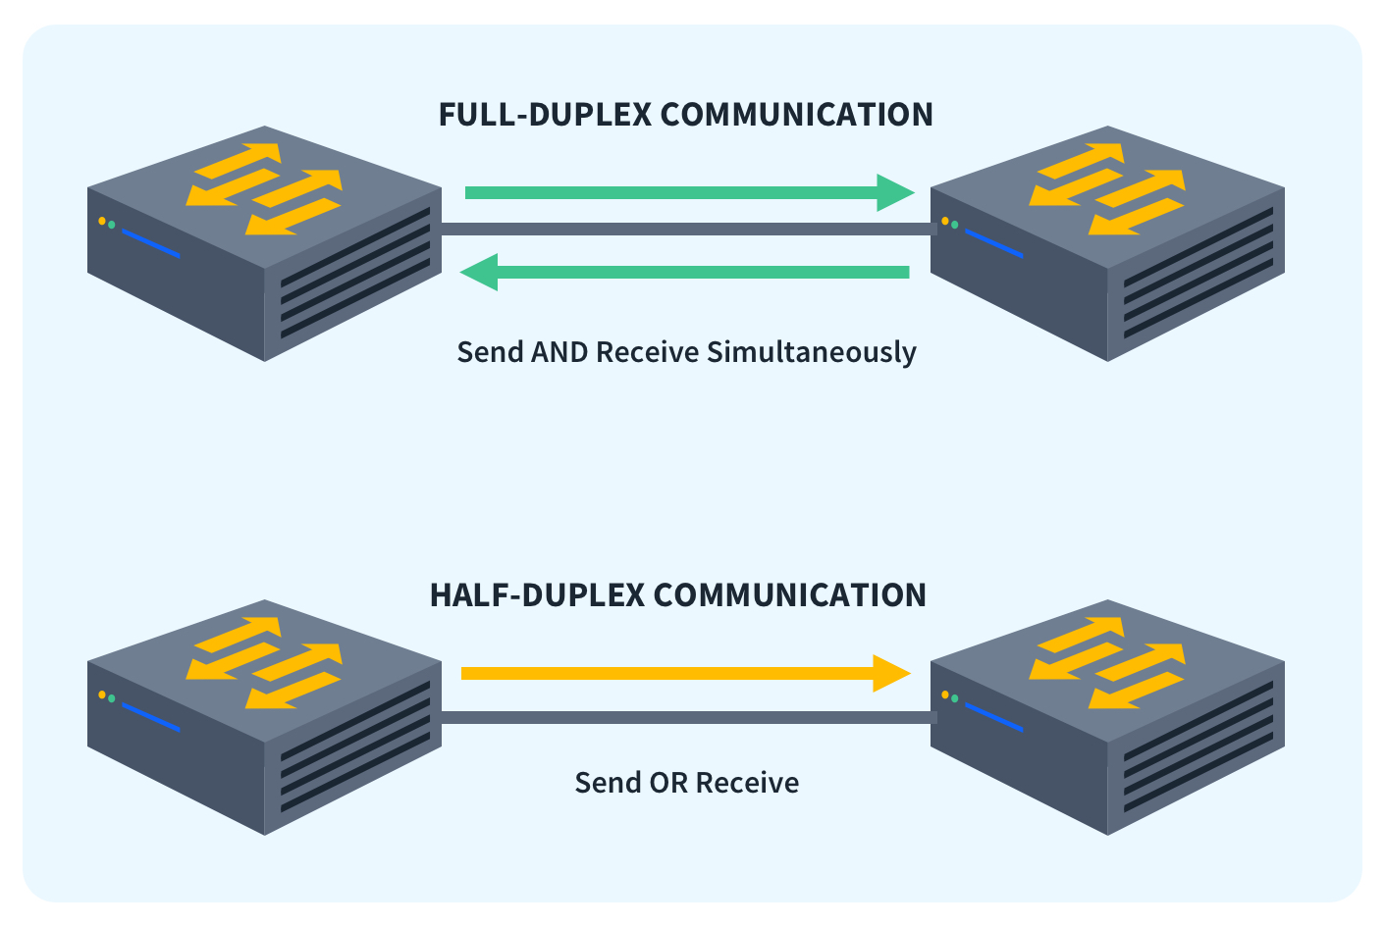
Link layer services (more)
Error detection:
errors caused by signal attenuation, noise.
receiver detects presence of errors:
signals sender for retransmission or drops frame
Error correction:
receiver identifies and corrects bit error(s) without resorting to retransmission (there are various protocols)
Full Duplex and Half Duplex:
Both devices can send and receive at the same time
Both devices can send and receive, but only one at a time

Slide 11
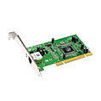
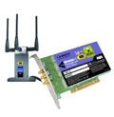

Where is the link layer implemented?
Link layer runs in the adaptor (NIC) or chipset
Ethernet card
802.11 (WiFi card)
Provides both link-layer and physical-layer functions
Connects the computer to the network (via system bus)
Combination of hardware, software, firmware
Every device has one
application
transport
network
link
cpu
memory
link
physical
host
bus
(e.g., PCI)
controller
physical
transmission
network adapter
card

Slide 12
Objectives – Part 1
Our objectives
Link Layer Addressing
MAC Address
Types of MAC Addresses
ARP
ARP within LAN
LAN Switch

Slide 13
Link Layer Addressing

Slide 14
MAC Address
A MAC address (Media Access Control address) is a unique identifier assigned to a network interface card (NIC) or adaptor.
Layer: Works at the Data-Link Layer (Layer 2 of the OSI model).
Purpose: Used for hop to hop communication
Uniqueness: Each device’s NIC has a unique MAC address worldwide.
Format: 48 bits (6 bytes), usually written as 6 pairs of hex numbers separated by colons or hyphens.
Example : 1A:2F:BB:76:09:AD

Slide 15
IP Address vs MAC Address
MAC address
48 bits
12 Hexadecimal digits
Example : 1A-2F-BB-76-09-AD
Data Link-layer address for interface
Flat
portable
Function
IP address
32 bits
Dotted decimal notation
Example : 192.168.10.1
Network-layer address for interface
Hierarchical
Not portable
Function

Slide 16
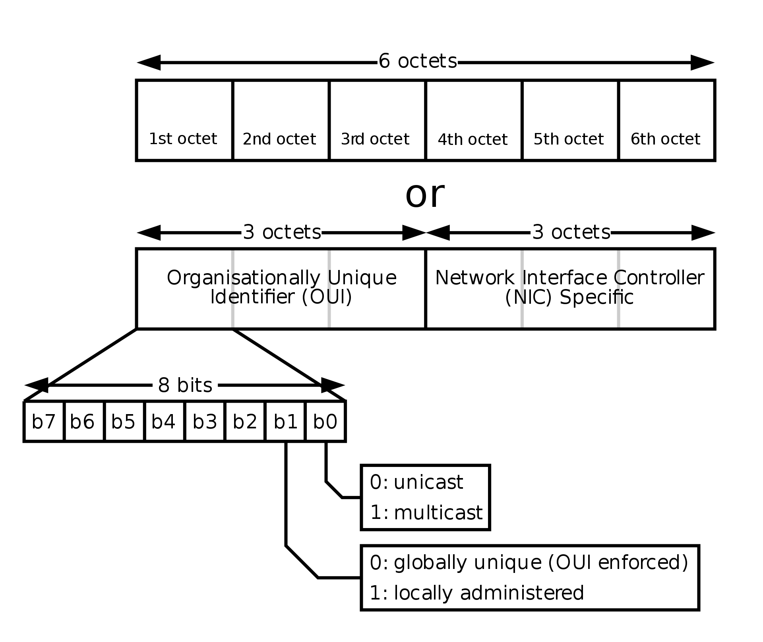


MAC Address
48 bits MAC address (for most LANs) burned in NIC ROM, also sometimes software settable
0000
1100
hexadecimal (base 16) notation
(each “numeral” represents 4 bits)

Slide 18
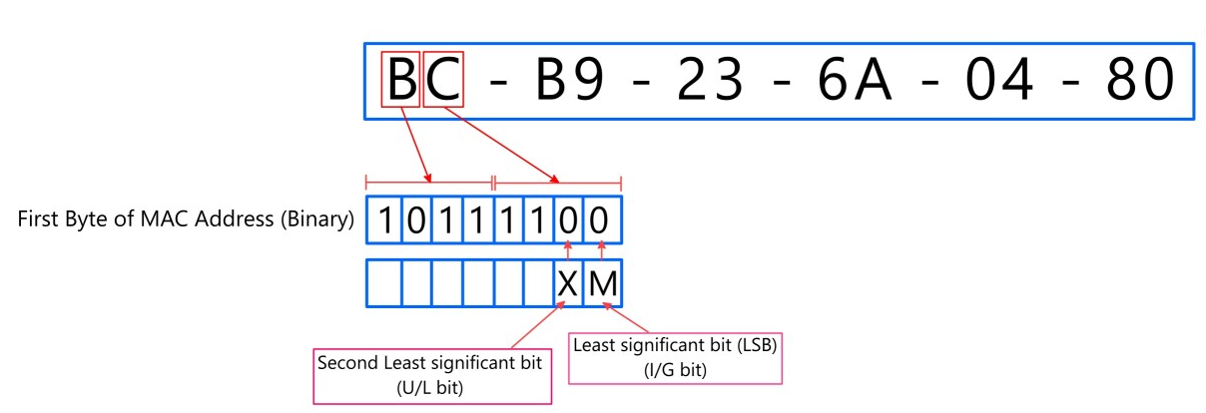
MAC Address
Unicast vs. Multicast Bit (Last bit of the first byte)
This bit decides who the MAC address is meant for.
If the last bit of the first byte = 0, the MAC address is unicast.
Means: the address belongs to one single device.
If the last bit of the first byte = 1, the MAC address is multicast.
Means: the frame is delivered to a group of devices.

Slide 19
MAC Address
Globally Unique vs. Locally Administered (Second-last bit of the first byte)
This bit decides who gave the address.
If the bit = 0, the MAC address is assigned by the manufacturer.
The MAC address is guaranteed to be Globally Unique.
If the bit = 1, the MAC address is changed manually (by an admin or software).
Used when you want to override the default.
This new address is not unique worldwide but works inside the local network.

Slide 20
MAC or LAN or Physical or Ethernet addresses (more)
48 bits MAC address (for most LANs) burned in NIC ROM, also sometimes software settable
MAC address allocation administered by IEEE
Manufacturer buys portion of MAC address space (to assure uniqueness)
Analogy:
MAC address: like National ID
IP address: like Postal Address

Slide 21
Types of MAC Address
Unicast
MAC Address
Multicast
Broadcast

Slide 22
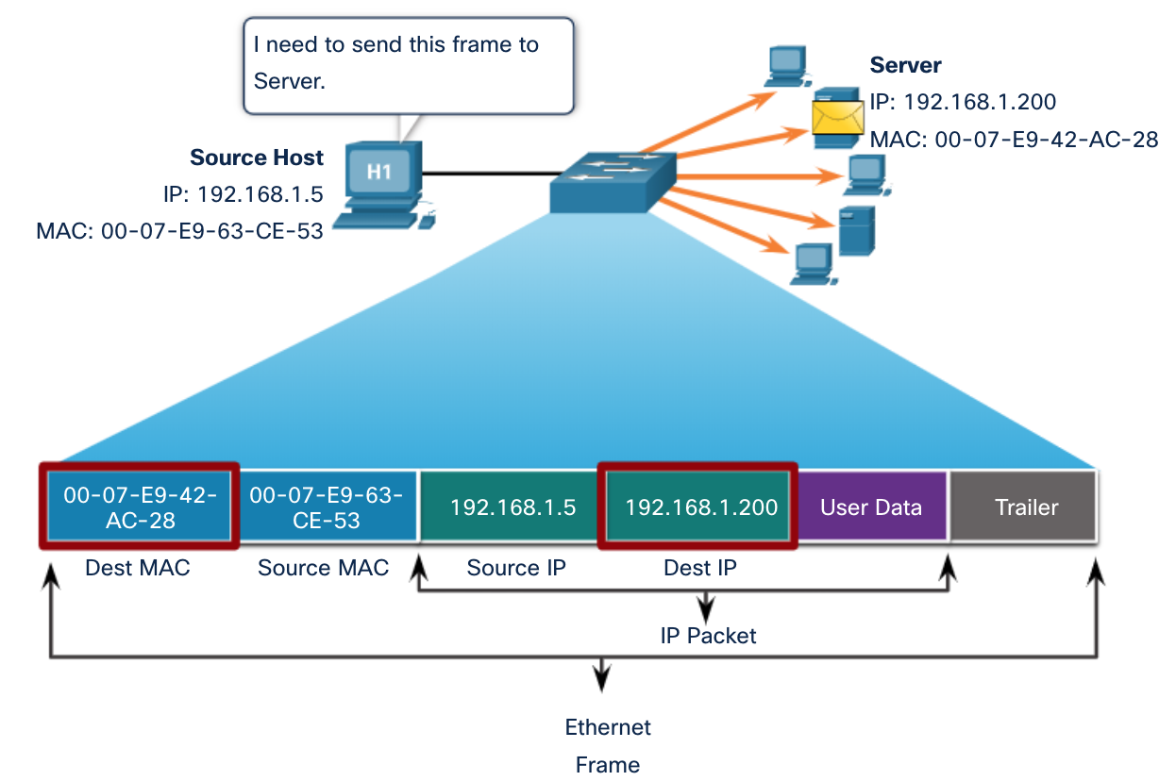
Unicast MAC Addresses
The unique address used when a frame is sent from a single transmitting device to a single destination device.

Slide 23
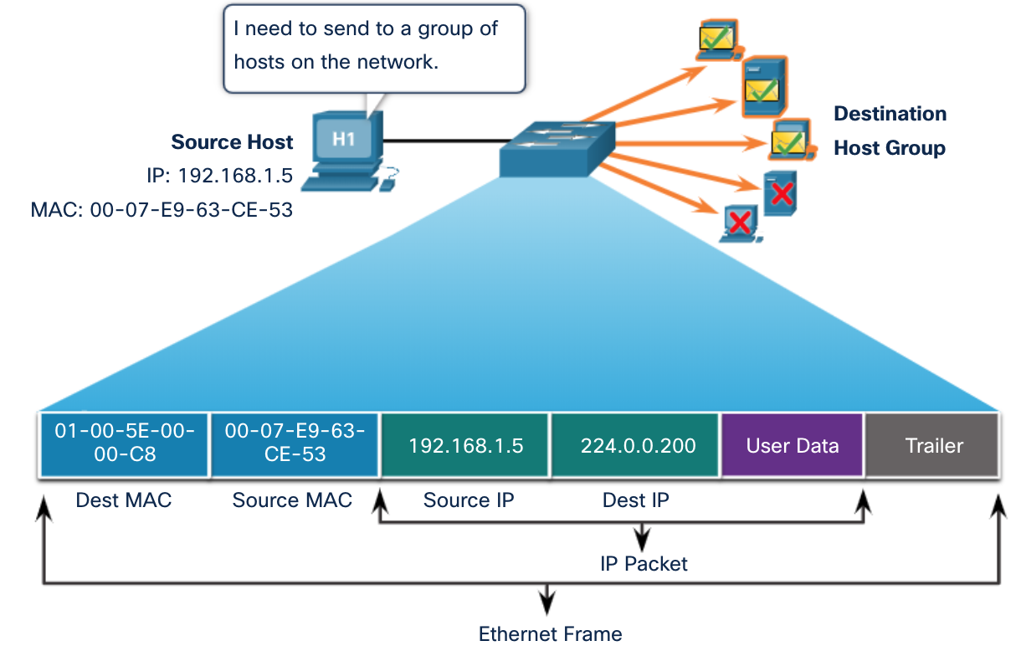
Multicast MAC Addresses
“ 01-00-5E” in an IPv4 multicast packet

Slide 24
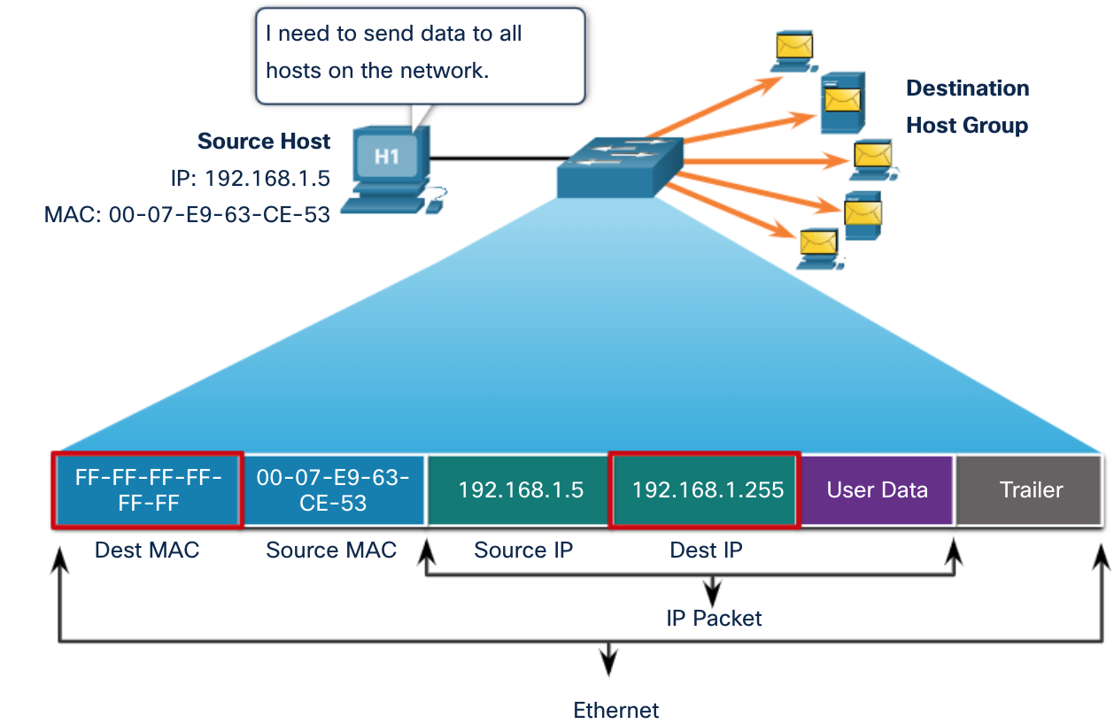
Broadcast MAC Address
A destination MAC address of FF-FF-FF-FF-FF-FF
To be processed by all devices in the network

Slide 25
LAN addresses and ARP
each adapter on LAN has unique LAN address
1A-2F-BB-76-09-AD
LAN
(wired or
wireless)
adapter
71-65-F7-2B-08-53
58-23-D7-FA-20-B0
0C-C4-11-6F-E3-98

Slide 26


ARP: address resolution protocol
Question: how to determine
interface’s MAC address, knowing its IP address?
ARP
Mapping _IP Add___ to _MAC Add____
ARP table
IP
MAC address
TTL (Time To Live) Or Age
time after which address mapping will be forgotten (typically 20 min)
137.196.7.78
1A-2F-BB-76-09-AD
137.196.7.23
137.196.7.14
LAN
71-65-F7-2B-08-53
58-23-D7-FA-20-B0
0C-C4-11-6F-E3-98
137.196.7.88

Slide 27
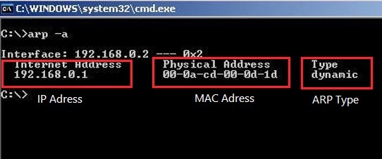
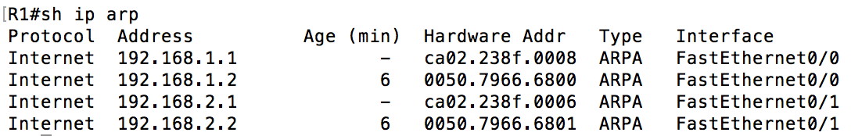
ARP Tables
Host or PC
Router

Slide 28
ARP: address resolution protocol
X
137.196.7.78
A wants to send datagram to B
1A-2F-BB-76-09-AD
137.196.7.23
ARP
137.196.7.14
A
ARP Reply
✔️
LAN
B
ARP
ARP
ARP
71-65-F7-2B-08-53
58-23-D7-FA-20-B0
0C-C4-11-6F-E3-98
137.196.7.88
X
71-65-F7-2B-08-53 | 58-23-D7-FA-20-B0 | 137.196.7.23 | 137.196.7.14 | ARP Reply
 | 71-65-F7-2B-08-53 | 137.196.7.14 | 137.196.7.23 | ARP Request
FF-FF-FF-FF-FF-FF
Dest MAC | Source MAC | Dest IP Add | Source IP Add | ARP Req/Reply

Slide 29
ARP protocol: same LAN
A wants to send datagram to B
B’s MAC address not in A’s ARP table.
A broadcasts ARP query packet, containing B's IP address
destination MAC address = FF-FF-FF-FF-FF-FF
all nodes on LAN receive ARP query
B receives ARP packet, replies to A with its (B's) MAC address
frame sent to A’s MAC address (unicast)
A caches (saves) IP-to-MAC address pair in its ARP table
Soft state: information that times out (goes away) unless refreshed
ARP is “plug-and-play”:
nodes create their ARP tables without intervention from net administrator
Notes:
until information becomes old (times out)

Slide 30
Addressing: routing to another LAN
Send datagram from A to B via R
focus on addressing – at IP (datagram) and MAC layer (frame)
assume A knows B’s IP address
What will be the destination MAC Address?
ARP- To know B’s MAC address as B’s IP address is known
Routers never forward broadcast packets!
A
B
R
111.111.111.111
222.222.222.222
74-29-9C-E8-FF-55
222.222.222.220
49-BD-D2-C7-56-2A
1A-23-F9-CD-06-9B
111.111.111.112
111.111.111.110
222.222.222.221
CC-49-DE-D0-AB-7D
E6-E9-00-17-BB-4B
88-B2-2F-54-1A-0F
 |  | 222.222.222.222 | 111.111.111.111 | A to B Packet
Default Gateway’s MAC Address
???
74-29-9C-E8-FF-55
Dest MAC | Source MAC | Dest IP Add | Source IP Add | Packet Type

Slide 31
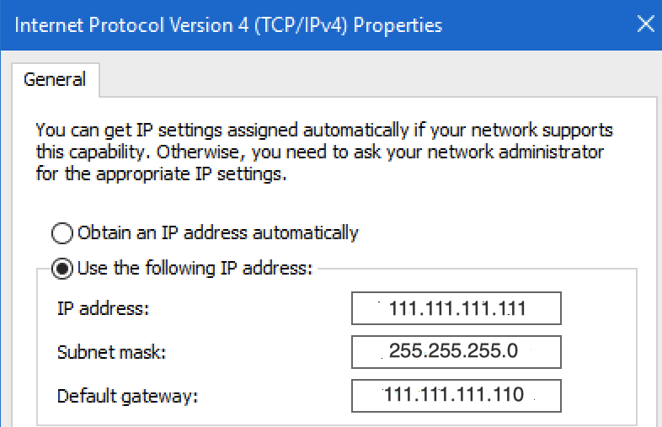
Addressing: routing to another LAN
Send datagram from A to B via R
Does A know the IP address of first hop router, R which is also known as Default Gateway? (how?)
Will A know R’s MAC address?
ARP
A
B
R
ARP
ARP Reply
111.111.111.111
ARP
222.222.222.222
74-29-9C-E8-FF-55
49-BD-D2-C7-56-2A
222.222.222.220
1A-23-F9-CD-06-9B
111.111.111.112
111.111.111.110
222.222.222.221
CC-49-DE-D0-AB-7D
E6-E9-00-17-BB-4B
88-B2-2F-54-1A-0F
 | 74-29-9C-E8-FF-55 | 222.222.222.222 | 111.111.111.111 | A to B Packet
E6-E9-00-17-BB-4B

Slide 32
Addressing: routing to another LAN
A creates IP datagram with IP source A, destination B
A creates link-layer frame with R's MAC address as destination address, frame contains A-to-B IP datagram
MAC src: 74-29-9C-E8-FF-55
MAC dest: E6-E9-00-17-BB-4B
IP
Eth
Phy
IP src: 111.111.111.111
IP dest: 222.222.222.222
A
B
R
111.111.111.111
222.222.222.222
74-29-9C-E8-FF-55
49-BD-D2-C7-56-2A
1A-23-F9-CD-06-9B
111.111.111.110
222.222.222.220
222.222.222.221
111.111.111.112
E6-E9-00-17-BB-4B
CC-49-DE-D0-AB-7D
88-B2-2F-54-1A-0F

Slide 33
Addressing: routing to another LAN
frame sent from A to R
frame received at R, datagram removed, passed up to IP
MAC src: 74-29-9C-E8-FF-55
MAC dest: E6-E9-00-17-BB-4B
IP src: 111.111.111.111
IP dest: 222.222.222.222
IP
Eth
Phy
IP src: 111.111.111.111
IP dest: 222.222.222.222
IP
Eth
Phy
A
B
R
111.111.111.111
222.222.222.222
74-29-9C-E8-FF-55
49-BD-D2-C7-56-2A
222.222.222.220
1A-23-F9-CD-06-9B
111.111.111.112
111.111.111.110
222.222.222.221
CC-49-DE-D0-AB-7D
E6-E9-00-17-BB-4B
88-B2-2F-54-1A-0F

Slide 34
Addressing: routing to another LAN
R forwards datagram with IP source A, destination B
R creates link-layer frame with B's MAC address as destination address, frame contains A-to-B IP datagram
MAC src: 1A-23-F9-CD-06-9B
MAC dest: 49-BD-D2-C7-56-2A
IP
Eth
Phy
IP
Eth
Phy
IP src: 111.111.111.111
IP dest: 222.222.222.222
A
ARP Reply
B
R
111.111.111.111
ARP
222.222.222.222
74-29-9C-E8-FF-55
ARP
ARP
49-BD-D2-C7-56-2A
222.222.222.220
1A-23-F9-CD-06-9B
111.111.111.112
111.111.111.110
222.222.222.221
CC-49-DE-D0-AB-7D
E6-E9-00-17-BB-4B
88-B2-2F-54-1A-0F

Slide 35
Addressing: routing to another LAN
R forwards datagram with IP source A, destination B
R creates link-layer frame with B's MAC address as destination address, frame contains A-to-B IP datagram
MAC src: 1A-23-F9-CD-06-9B
MAC dest: 49-BD-D2-C7-56-2A
IP
Eth
Phy
IP
Eth
Phy
IP src: 111.111.111.111
IP dest: 222.222.222.222
A
B
R
111.111.111.111
222.222.222.222
74-29-9C-E8-FF-55
49-BD-D2-C7-56-2A
222.222.222.220
1A-23-F9-CD-06-9B
111.111.111.112
111.111.111.110
222.222.222.221
CC-49-DE-D0-AB-7D
E6-E9-00-17-BB-4B
88-B2-2F-54-1A-0F

Slide 36
Addressing: routing to another LAN
R forwards datagram with IP source A, destination B
R creates link-layer frame with B's MAC address as dest, frame contains A-to-B IP datagram
MAC src: 1A-23-F9-CD-06-9B
MAC dest: 49-BD-D2-C7-56-2A
IP src: 111.111.111.111
IP dest: 222.222.222.222
IP
Eth
Phy
A
B
R
111.111.111.111
222.222.222.222
74-29-9C-E8-FF-55
49-BD-D2-C7-56-2A
222.222.222.220
1A-23-F9-CD-06-9B
111.111.111.112
111.111.111.110
222.222.222.221
CC-49-DE-D0-AB-7D
E6-E9-00-17-BB-4B
88-B2-2F-54-1A-0F
* Check out the online interactive exercises for more examples: http://gaia.cs.umass.edu/kurose_ross/interactive/

Slide 37
Objectives
Switch
Characteristics of a switch
Role of switch in a LAN

Slide 38
Switch
link-layer device: takes an active role
store, forward frames
examine incoming frame’s MAC address in each frame to decide where it should go
uses CSMA/CD when sending on a shared segment.
transparent
hosts are unaware of presence of switches
plug-and-play, self-learning
switches do not need to be configured

Slide 39
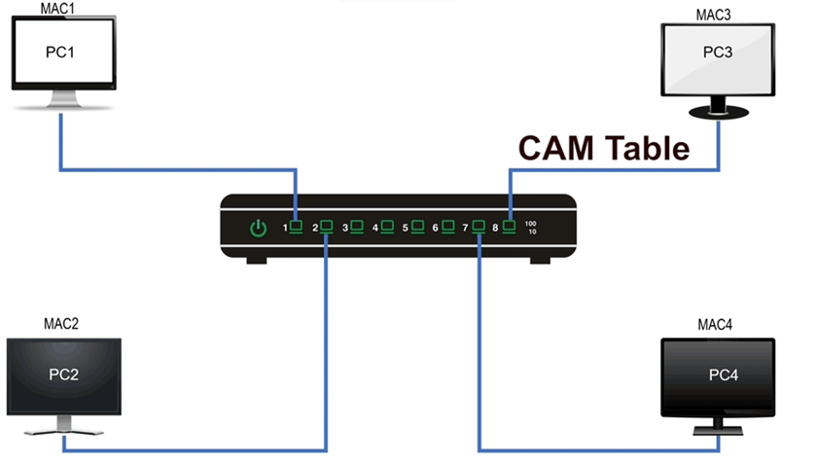
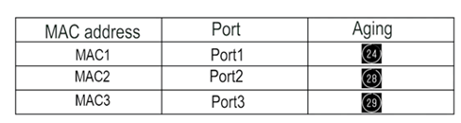
Switch forwarding table
Q: how does switch know PC3 reachable via interface 8, Pc2 reachable via interface 2?
A: each switch has a switch table
Each entry:
MAC address of host, interface to reach host, time stamp

Slide 40
Switch
hosts have dedicated, direct connection to switch
switches buffer packets
Q: how are entries created, maintained in switch table?
Manual?
Dynamic?

Slide 41

Switch: self-learning
Source: A
Dest: A’
The table is empty initially
When it receives a frame, it looks at the source MAC address.
It learns : “This MAC address is reachable through this port.”
Saves this info in its switching table for future use.
A
A A’
C’
B
6
1
2
5
4
3
B’
C
A’
MAC addr interface TTL
A
1
60
Switch table
(initially empty)

Slide 42
Switch: frame filtering/forwarding
when frame received at switch:
1. record incoming link, MAC address of sending host
2. index switch table using MAC destination address
3. if entry found for destination then {
if destination on segment from which frame arrived then drop frame
else forward frame on interface indicated by entry
}
else flood /* forward on all interfaces except arriving
interface */

Slide 43
Self-learning, forwarding: example
Source: A
Dest: A’
A
A A’
frame destination, A’, location unknown:
C’
B
flood
6
1
2
5
4
3
B’
C
A’
A’
4
60
MAC addr interface TTL
A
1
60

Slide 44
Self-learning, forwarding: example
A’ now wants to reply
A
C’
B
Switch looks at source MAC Address :
6
1
2
learns
5
4
3
B’
C
Switch looks at destination MAC Address : ?
Source: A
Dest: A’
A’
A’ A
destination A location is known
MAC addr interface TTL
selectively sends/forwards
A
1
60
A’
4
60

Slide 45

Interconnecting switches
self-learning switches can be connected together:
S₄
S₁
S₃
A
S₂
F
I
B
C
D
E
G
H
Q: sending from A to G - how does S₁ know to forward frame destined to G via S₄ and S₃?
A: self learning! (works exactly the same as in single-switch case!)

Slide 46
Self-learning multi-switch example
Suppose C sends frame to I, I responds to C
S₄
S₁
S₃
A
S₂
F
I
B
C
D
E
G
H
Q: show switch tables and packet forwarding in S₁, S₂, S₃, S₄

Slide 47
Institutional network
mail server
to external
network
router
web server
IP subnet

Slide 48
Switches vs. routers
application
transport
network
link
physical
both are store-and-forward:
routers: network-layer devices (examine network-layer headers)
switches: link-layer devices (examine link-layer headers)
both have forwarding tables:
routers: compute tables using routing algorithms, IP addresses
switches: learn forwarding table using flooding, learning, MAC addresses
datagram
frame
link
physical
frame
switch
network
link
physical
datagram
frame
application
transport
network
link
physical

Slide 49
THE END!

